Slide 1
Counter:
Asynchronous
UNIT-6
Sequential Logic Circuits Applications

Slide 2
What is Counter?
That goes through a prescribed sequence of states upon the application of input pulses.
Cascade combination of multiple flip-flops.
Generally used for the purpose of counting in digital circuits
Total number of counts represent the number of clock pulses arrived.

Slide 3
Two types of counters:
  asynchronous (ripple) counters
  synchronous (clocked /parallel) counters

Slide 4
Difference between synchronous and asynchronous
Synchronous | Asynchronous
triggered simultaneously by the same clock. | Various flip-flops are activated with different clocks
Operation speed - faster. | comparatively slower
No propagation delay | Subsequent propagation delay
any desired count sequence, | can operate only in a fixed count sequence, i.e., UP and DOWN
Examples are Johnson and Ring counters. | Examples are Ripple UP counter and Ripple DOWN counter

Slide 5
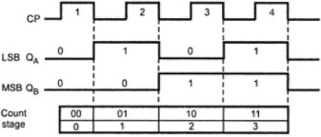

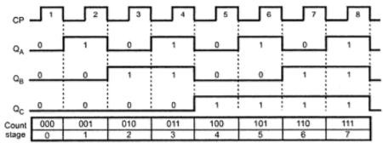
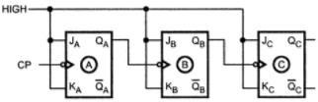
Asynchronous Counter

Slide 6
Design Steps of 3 bit Synchronous counter
Step 1: Find the number of flip flops.
Step 2: Choose the type of flip flop.
Step-3: Draw state diagram for the counter.
Step-4: Obtain excitation table for the counter.
Step 5: Derive the flip flop input functions (use K-Map)
Step-6: Draw the logic diagram of the counter.

Slide 7
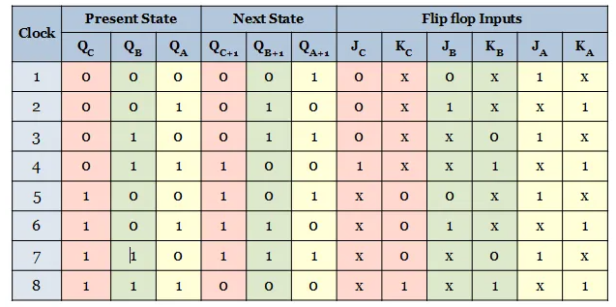
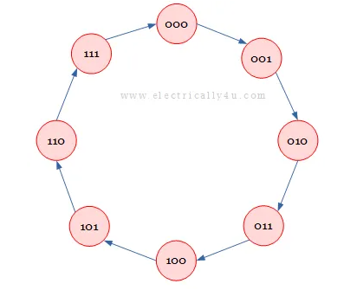
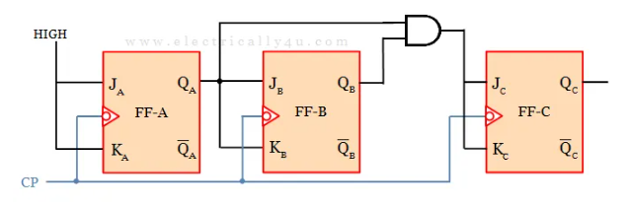

Slide 8
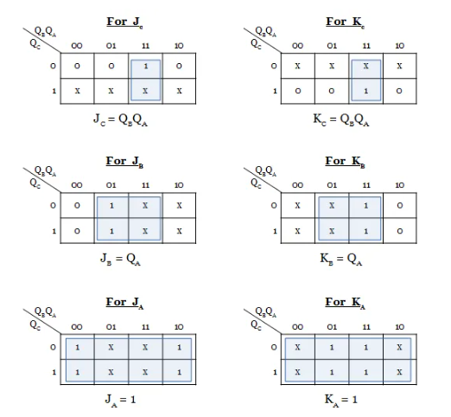

Slide 9
Which one is true for JK flip if present state 0 and next state 0.
(a) J= X and K= 0
(b) J= 0 and K= X
( c) J= X and K= 1
(d) J= 1 and K= X

Slide 10
Which one is true for JK flip if present state 1 and next state 1.
(a) J= X and K= 0
(b) J= 0 and K= X
( c) J= X and K= 1
(d) J= 1 and K= X

Slide 11
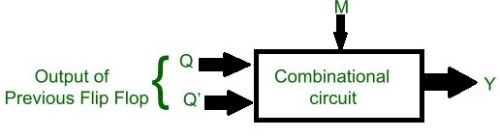
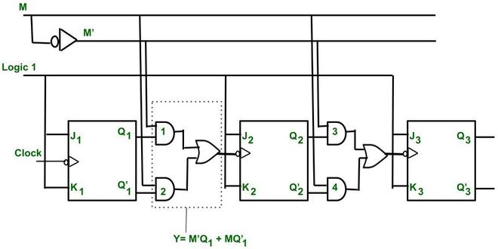
UP/Down ASynchronous Counter

Slide 12
